Slide 1

OFFICE HOURS
KATY GETTINGER EAGEN
VICE PRESIDENT, GROUP SALES
KATE ANTHONY
DIRECTOR, GROUP SALES – MID-ATLANTIC
CINDY TAYLOR
VICE PRESIDENT, GLOBAL MEETINGS & EVENTS
JONATHAN HOWE
PRESIDENT, HOWE & HUTTON, LTD.

Slide 2
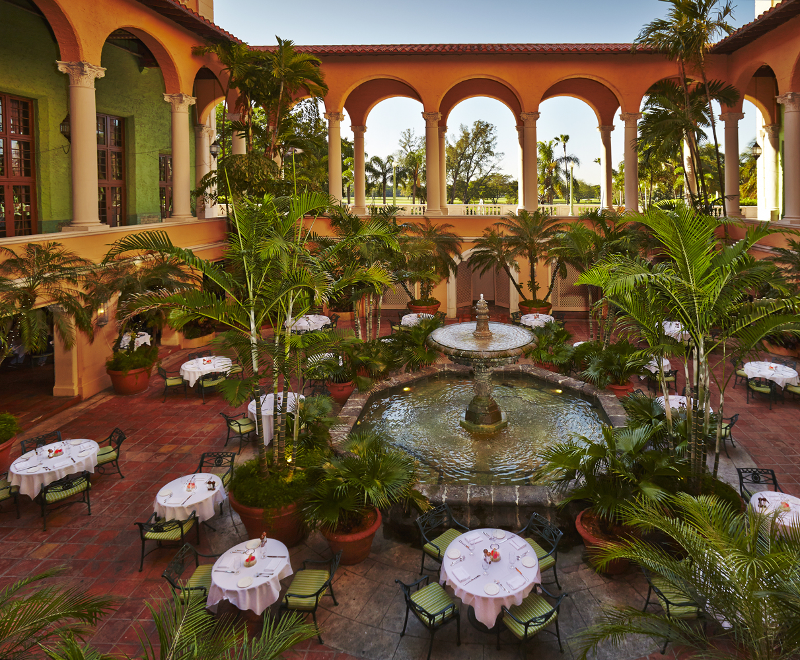
Decisions and length of contracting increase
Increase booked revenue Midwest / Southwest
Increase in Definite Bookings
JULY TRENDS

Slide 3
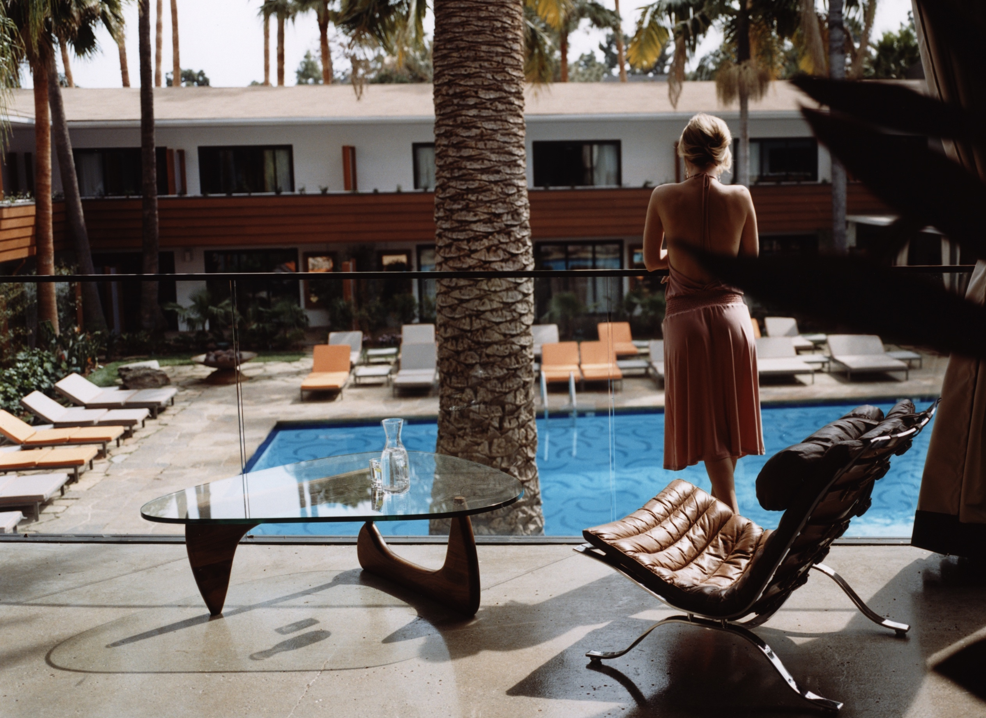
B
July 2020
New Definite Business Booked
320%
Increase over June 2020
GROWTH

Slide 4


Slide 5
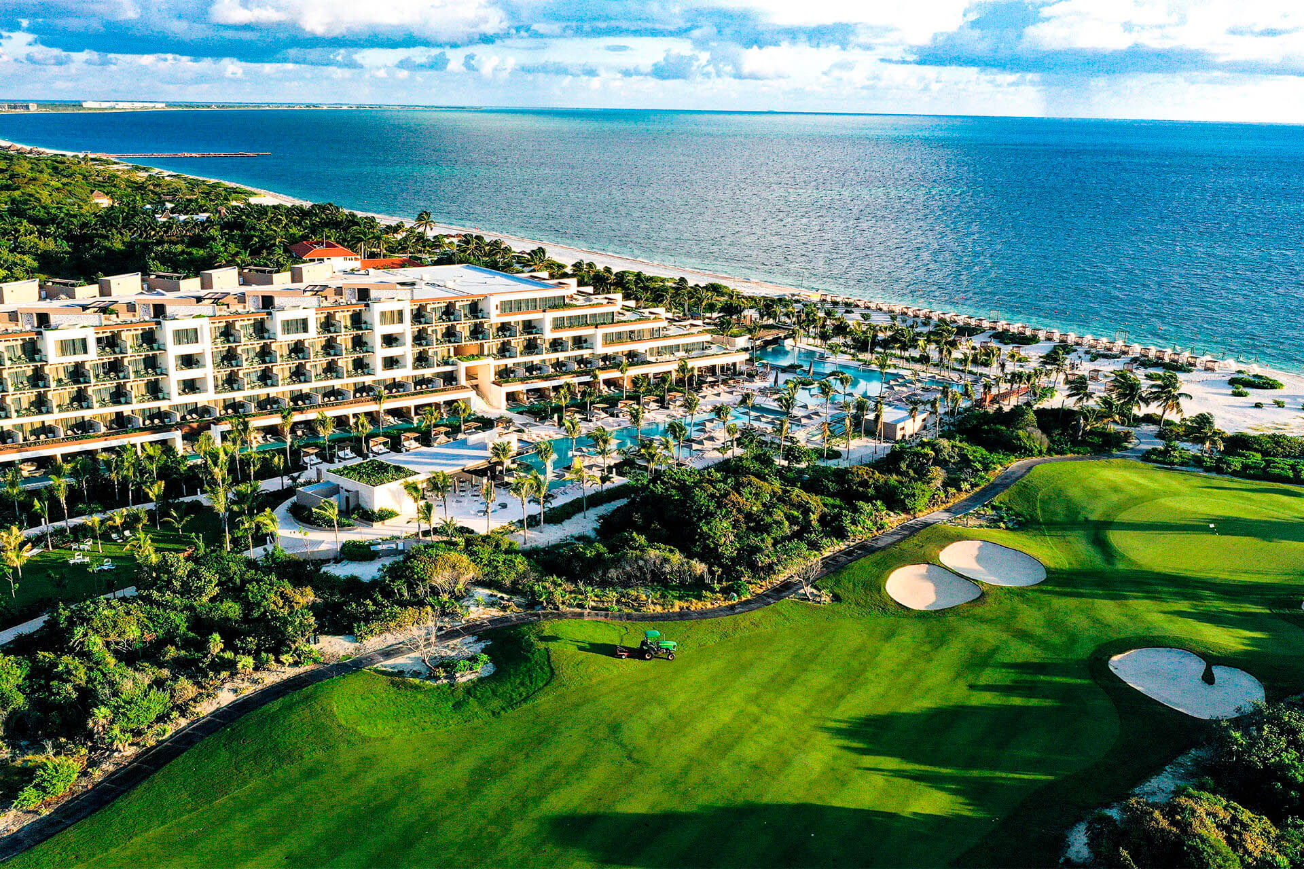
Mid-Atlantic / Association US
MArket includes: DC, DE, GA, IN, KY, MD, NC, OH, PA, SC, VA, WV
THE NEW NORMAL A BRIDGE TO THE FUTURE
CURRENT TRENDS:
Smaller, regional events
Focus on drive market
Flexibility during contracting and execution
Hybrid Meetings
Need for strong bandwidth and IT infrastructure
Market Updates

Slide 6
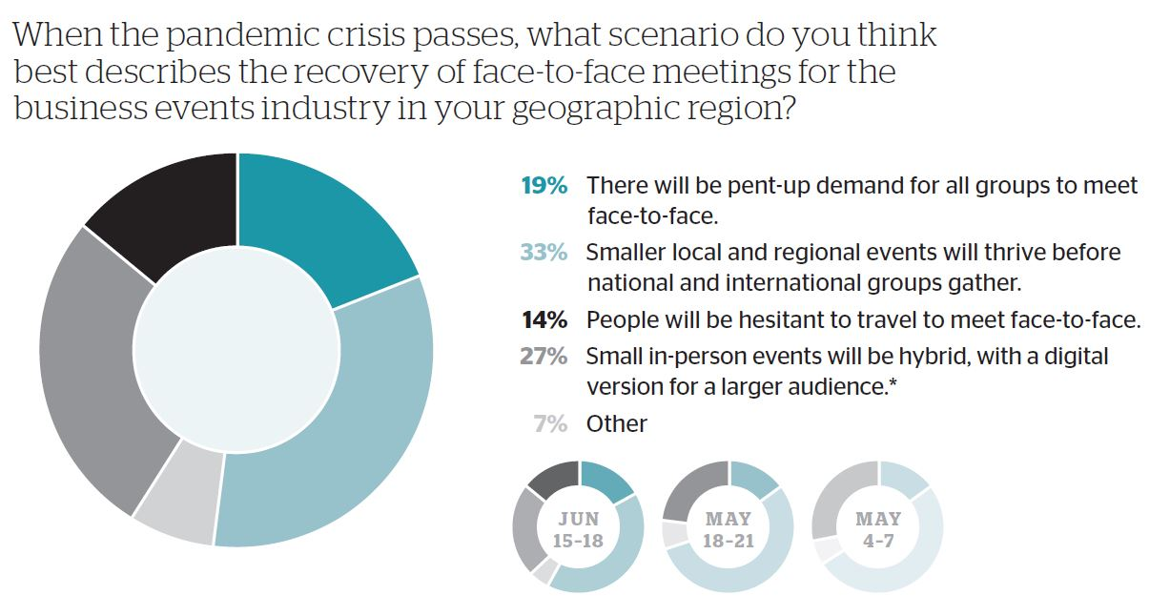
Market Updates

Slide 7
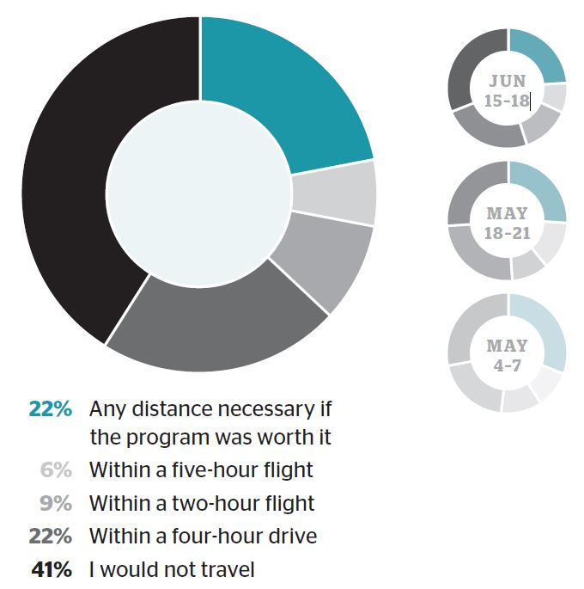
In the absence of a therapeutic treatment or vaccine for the COVID-19 virus, what is the farthest distance from your home you would consider traveling to a business event in 2020, assuming there are no financial or regulatory restrictions placed on travel?
Market Updates

Slide 8
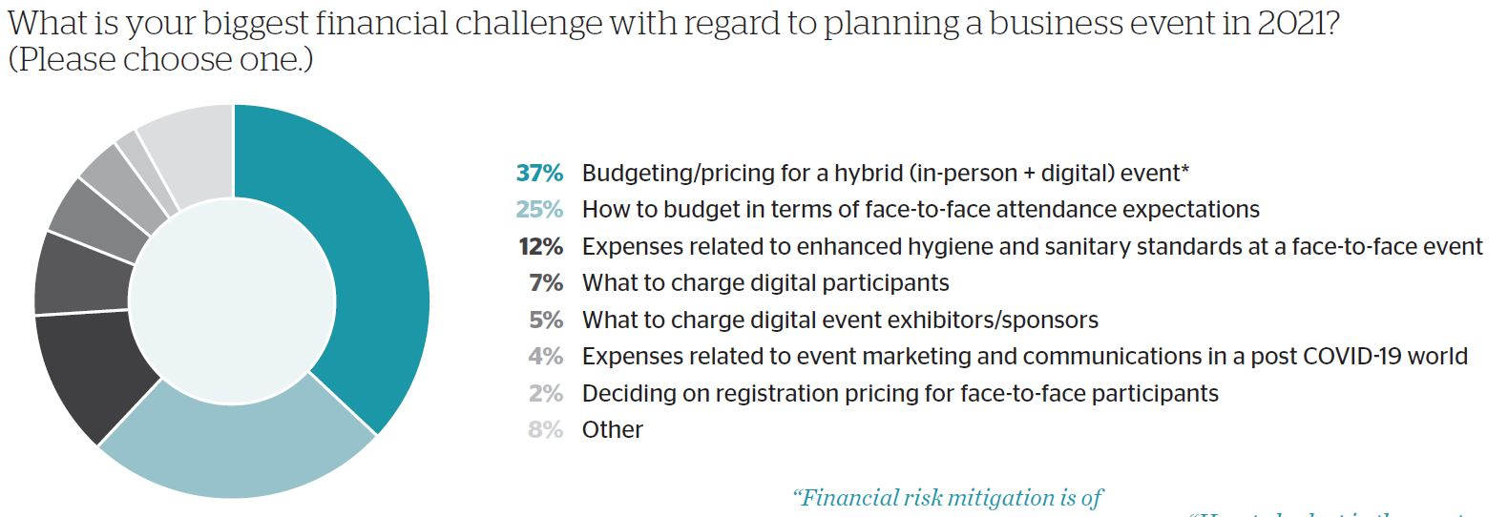
Market Updates

Slide 9
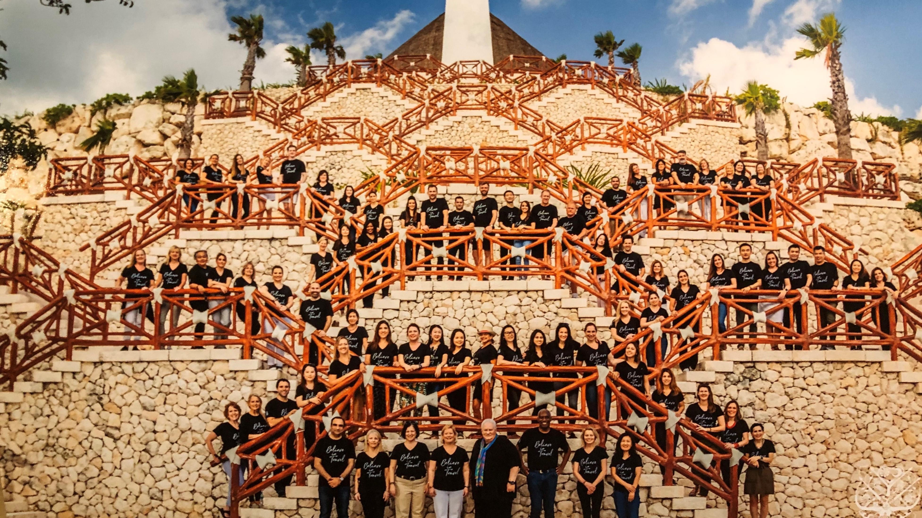

Slide 10


Slide 11
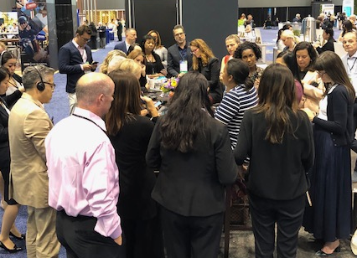
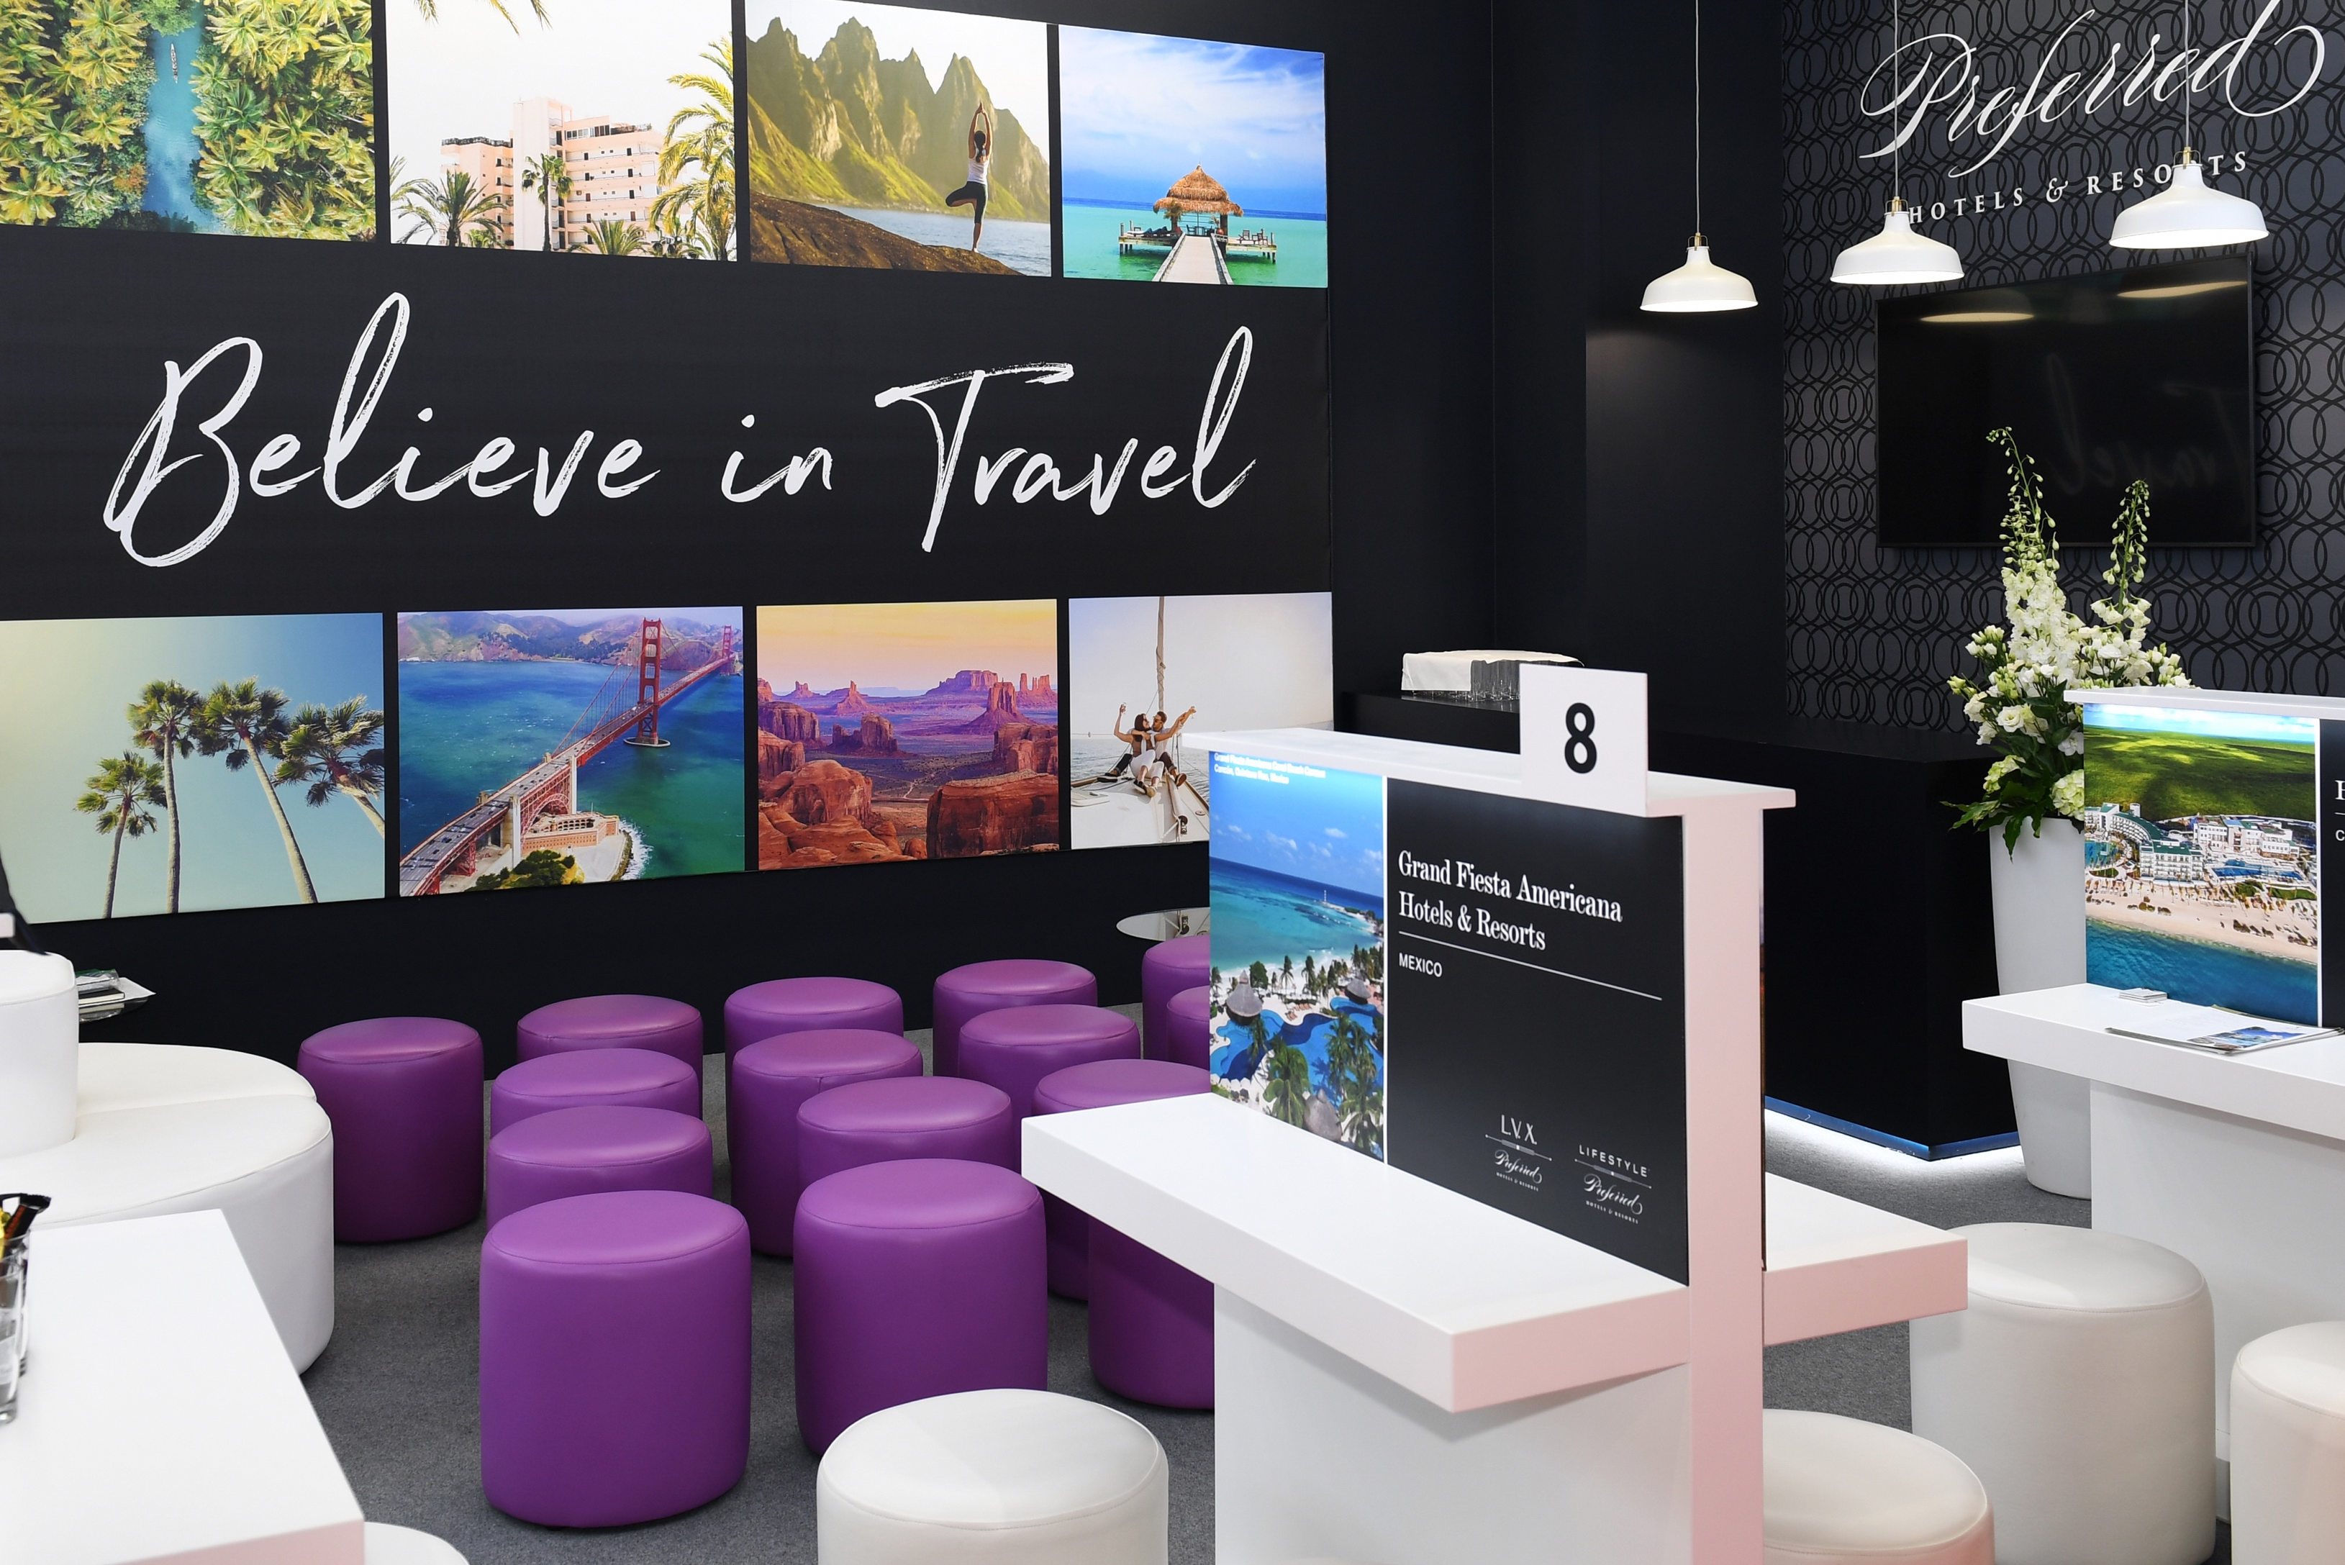
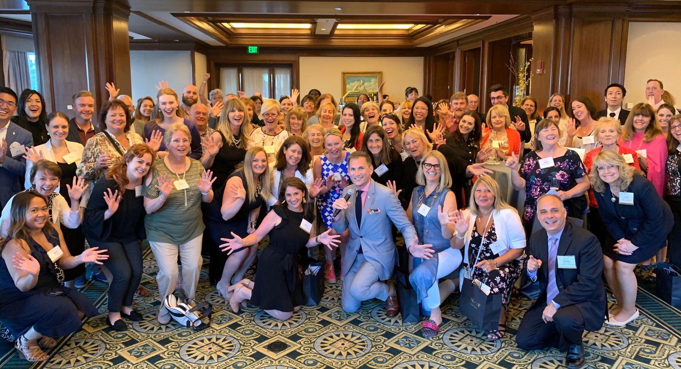
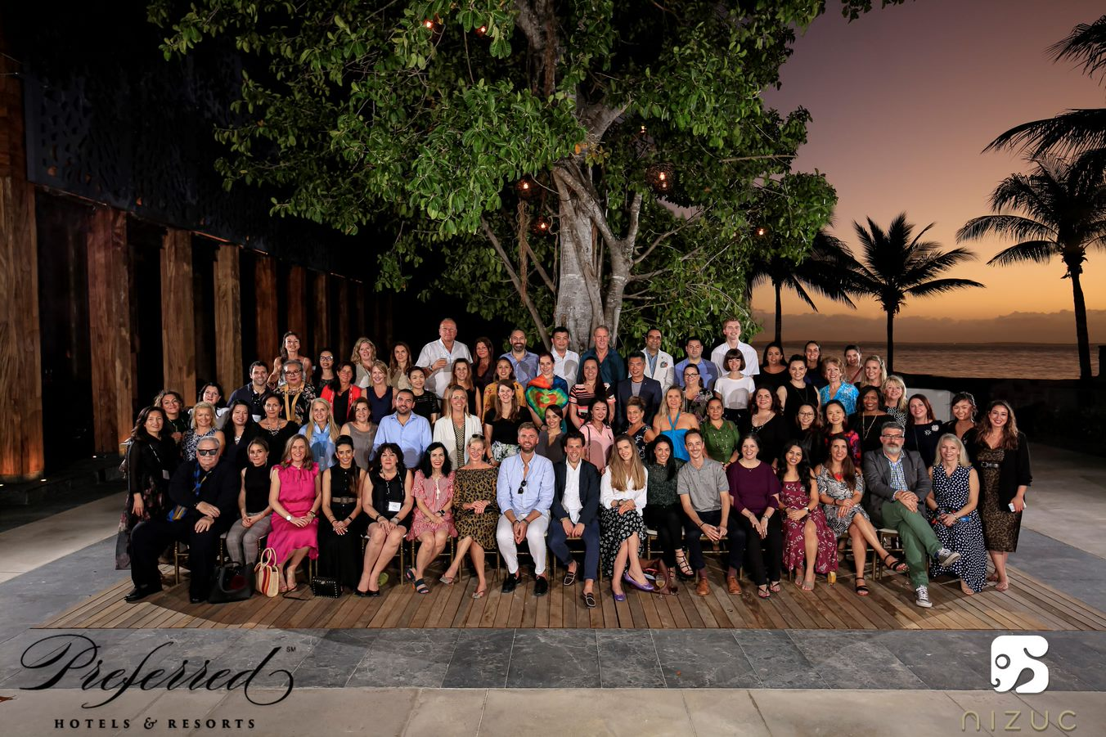
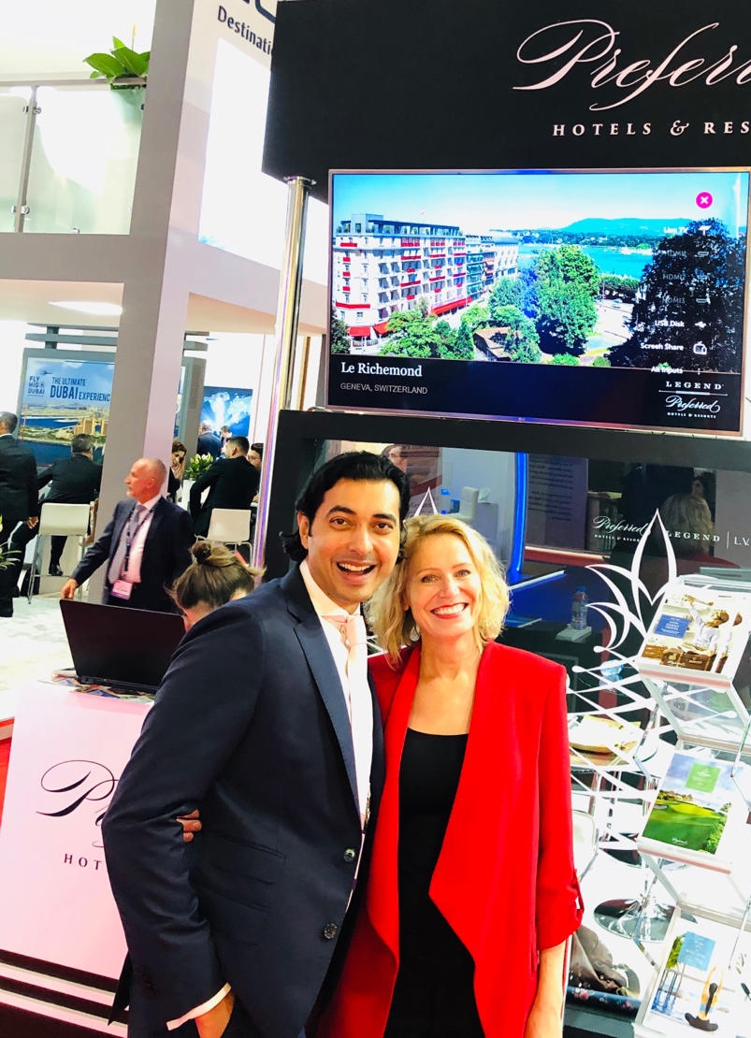
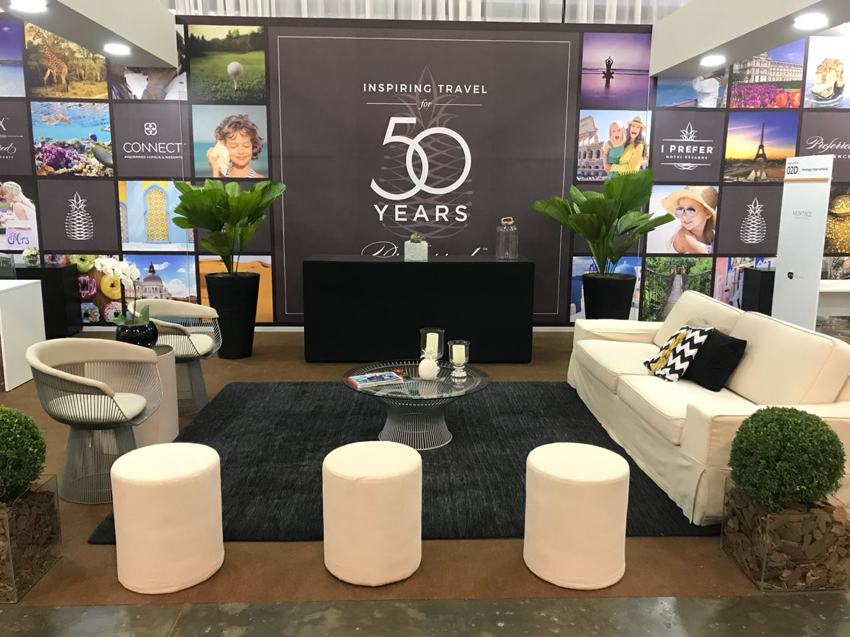
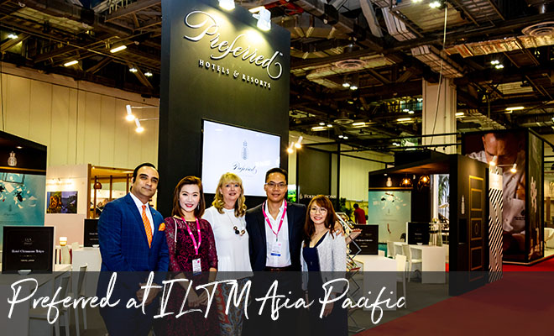
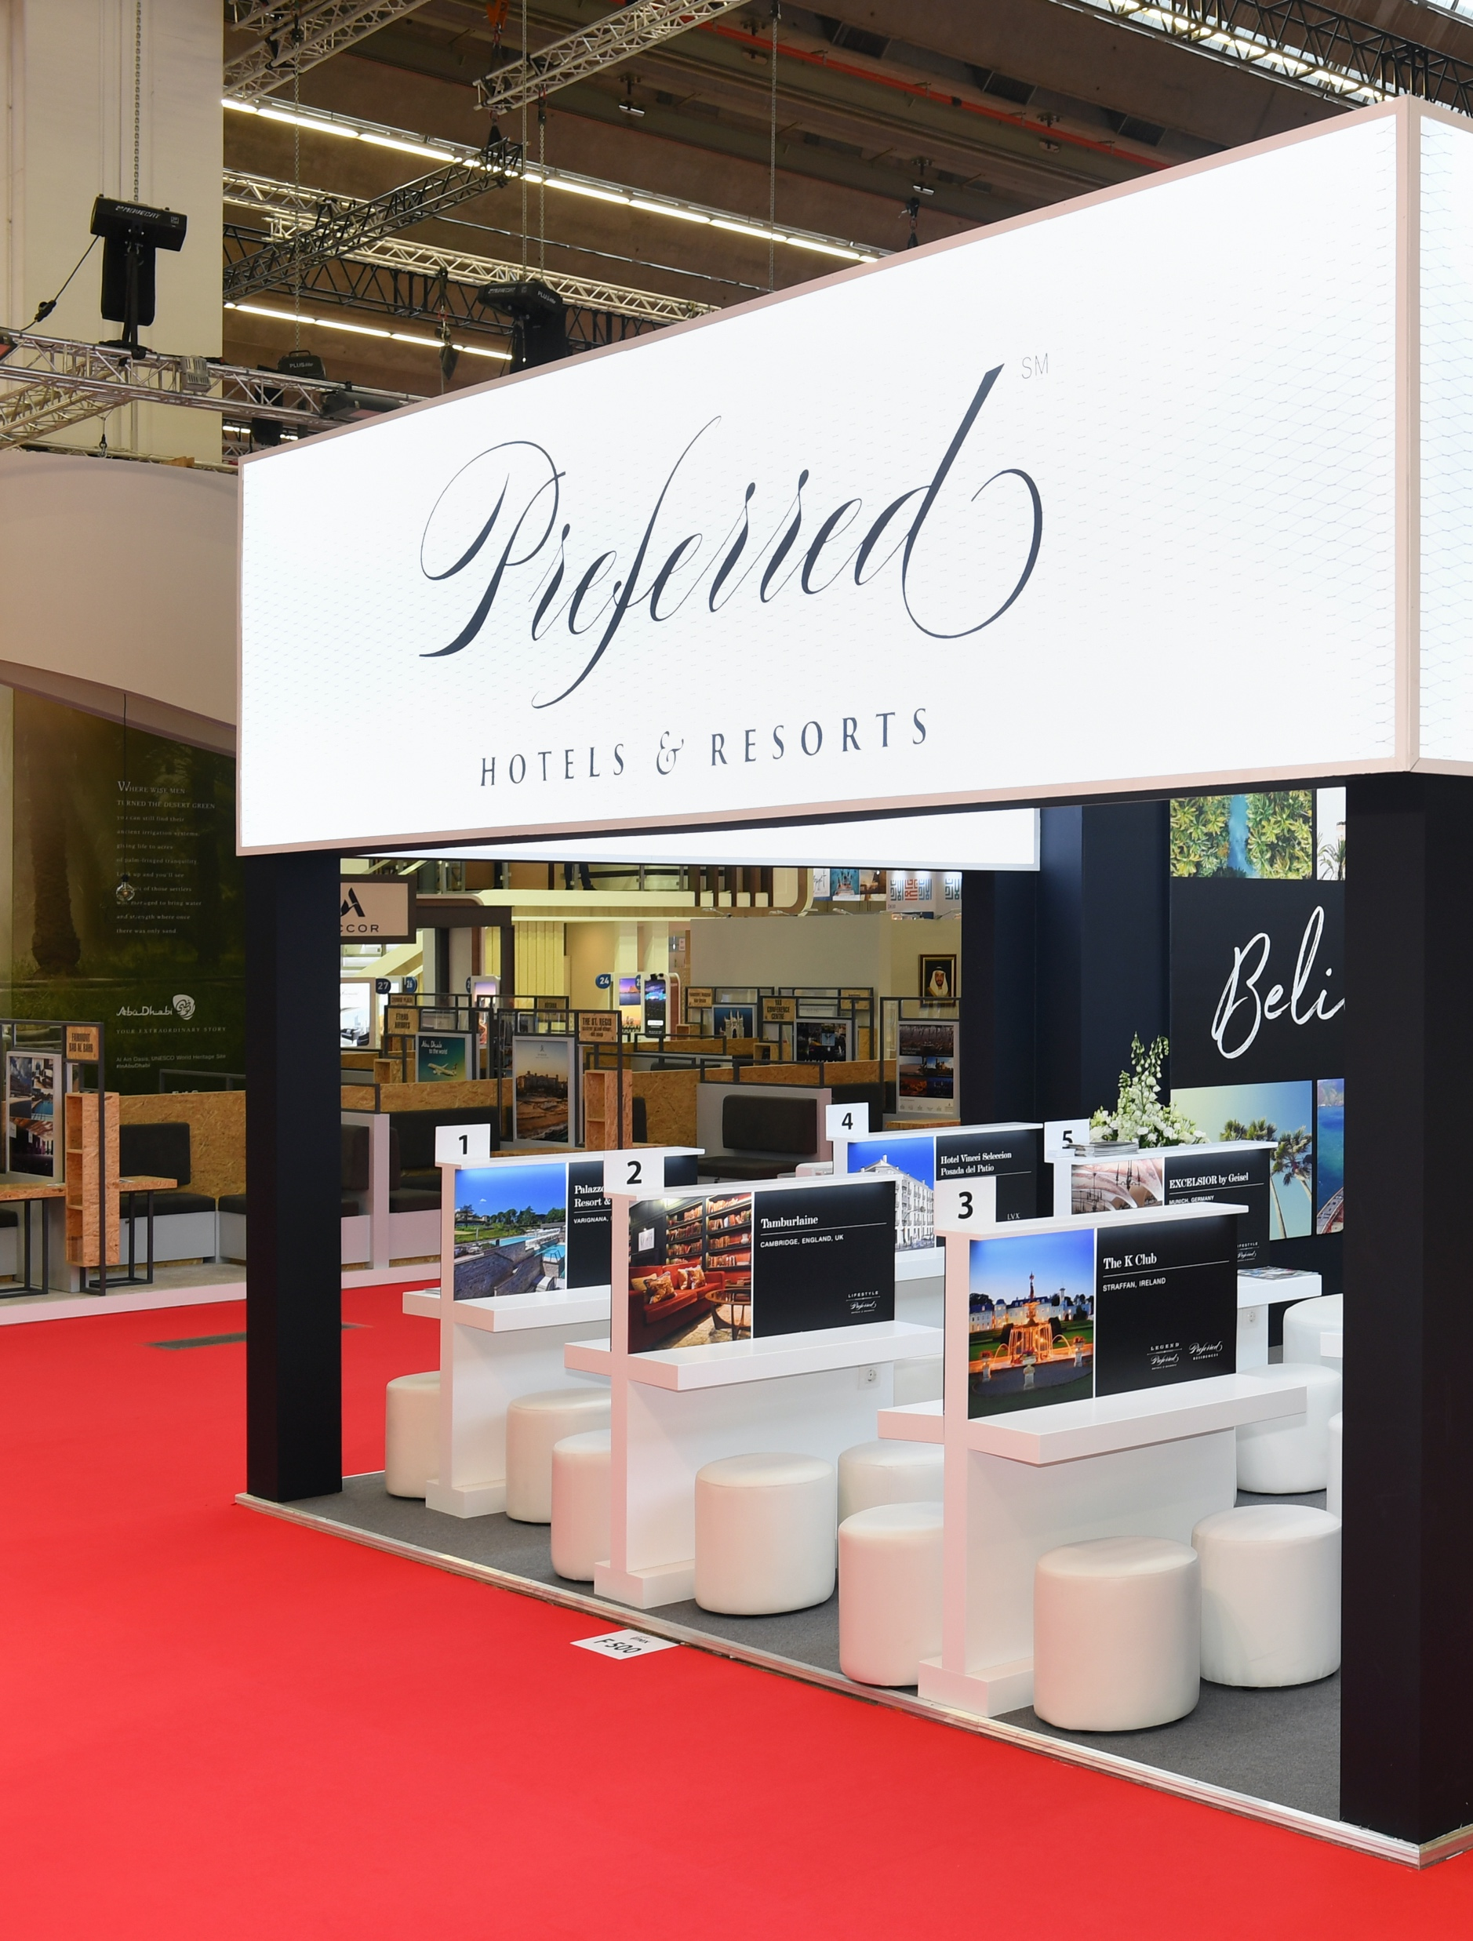
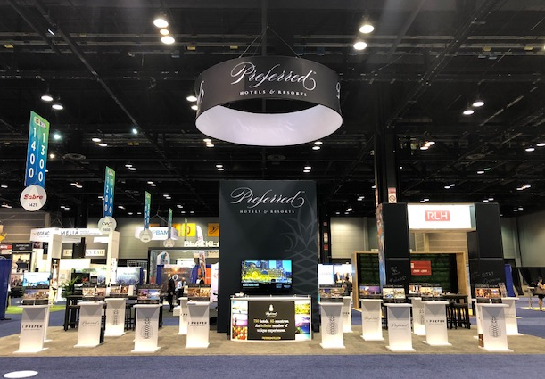
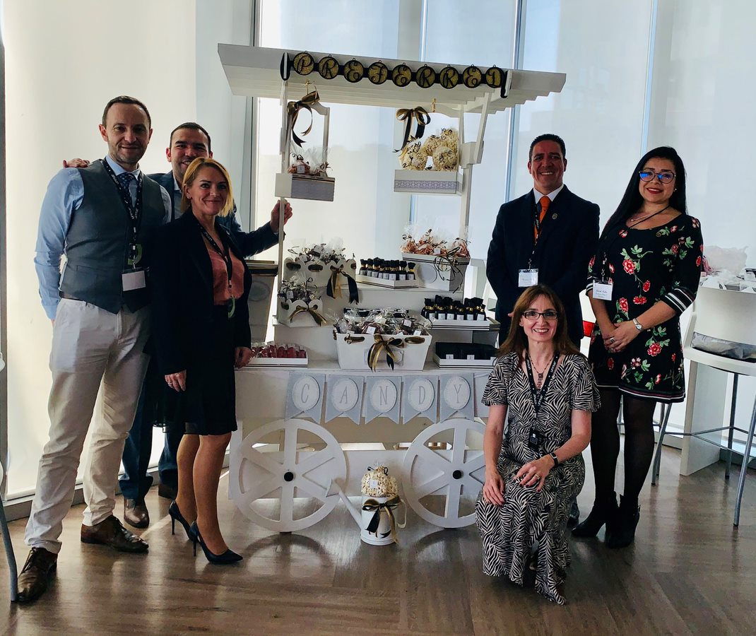
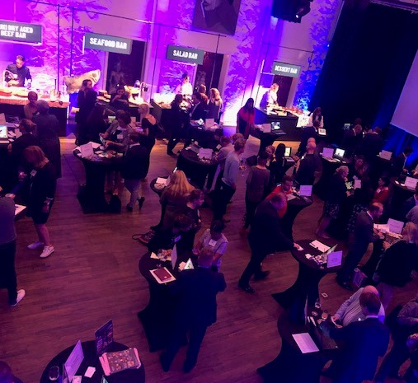
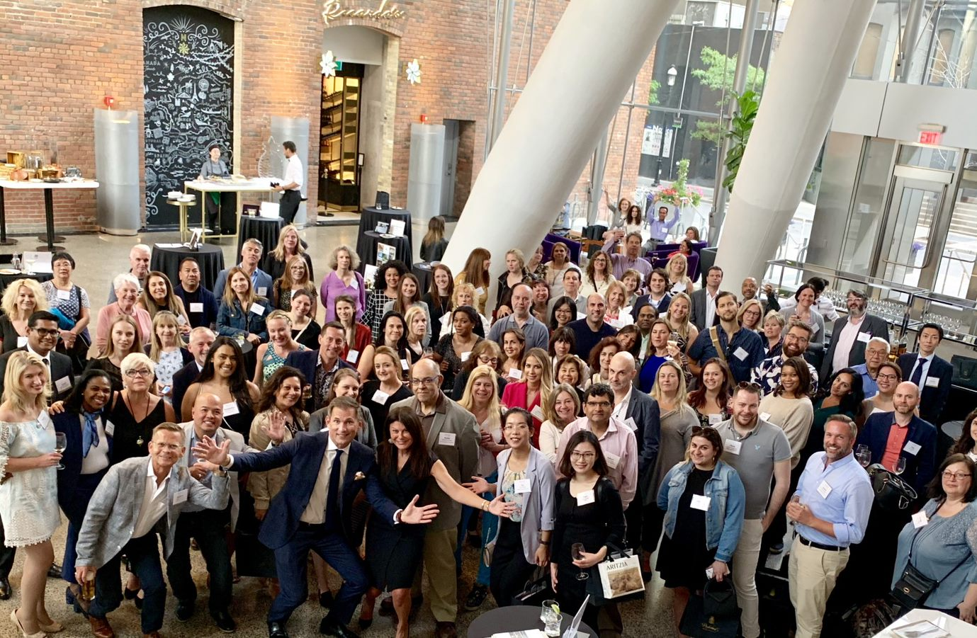
Preferred Hotels & Resorts
Meetings & Events
The Show Must Go On(Line)
Connectedness

Slide 12



Custom Curated
Virtual Events
Engagement = Results
Strategically designed formats and activities for specific customer segments
Carefully selected customers with business for you
Market Updates
THOUGHT LEADERSHIP

Slide 13
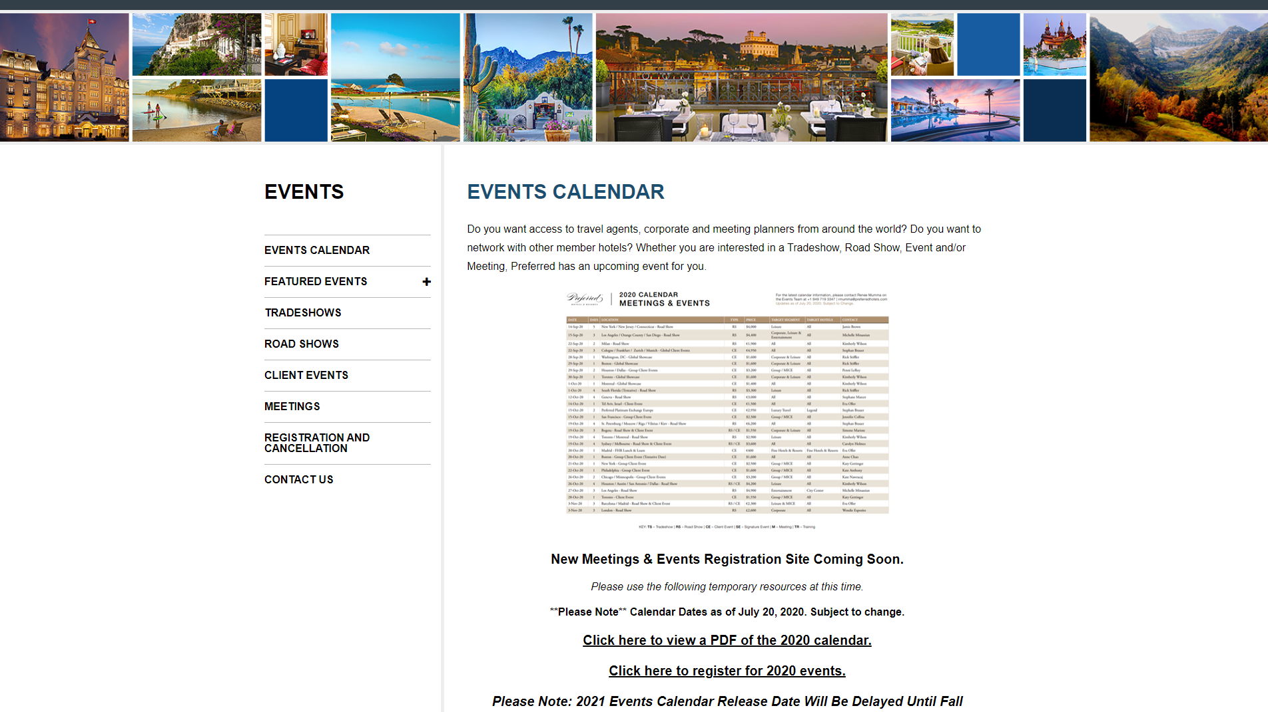
PreferredNet.net

Slide 14



Slide 15
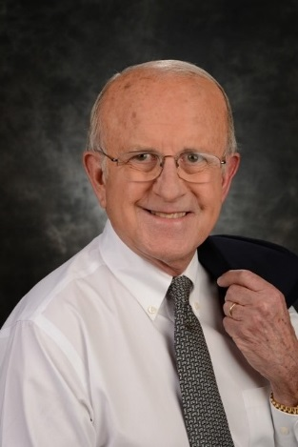
Jonathan T. Howe, Esq.
Howe & Hutton, Ltd
President and Partner of Howe & Hutton, Ltd., a law firm with offices in Chicago, McLean VA and Washington, D.C.
Serves as general counsel for MPI
General counsel Association Committee of 100 sponsored by the U.S. Chamber of Commerce.
The legal editor for Meetings & Conventions and The Meeting Professional.
Author of hundreds of articles, papers and books, and has spoken to organizations all over the world on all manner of legal issues.
Holds a Bachelor of Arts degree majoring in diplomatic history and international political science with honors from Northwestern University and his Juris Doctorate with highest distinction from Duke University
Lorum Ipsum
Lorum
Guest Speaker
Preferred Hotels & Resorts retains strong relationships with the top luxury programs in the world.

Slide 16
Lorum Ipsum
Lorum
Jonathan T. Howe, Esq.
Howe & Hutton, Ltd
125 S. Wacker Drive
Suite 2310
Chicago IL, 60606
jth@howehutton.com
(312) 263-3001
Guest Speaker
Preferred Hotels & Resorts retains strong relationships with the top luxury programs in the world.

Slide 17
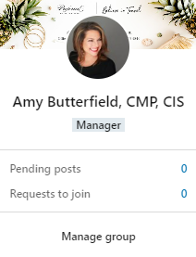
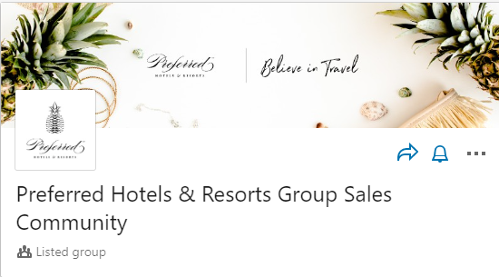
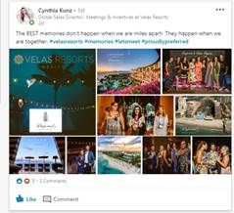
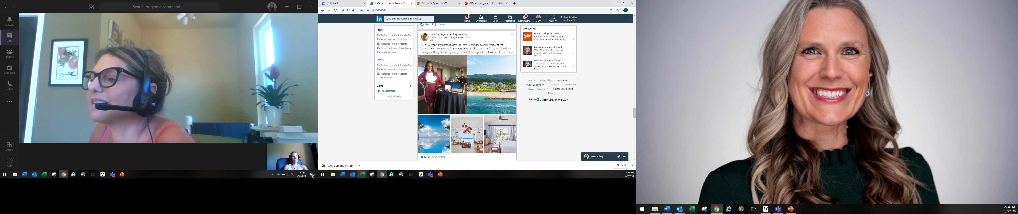
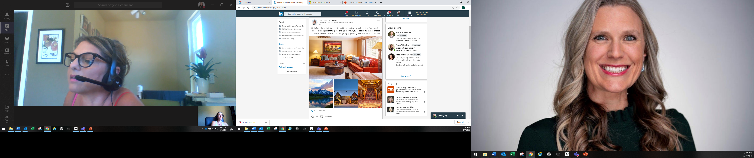
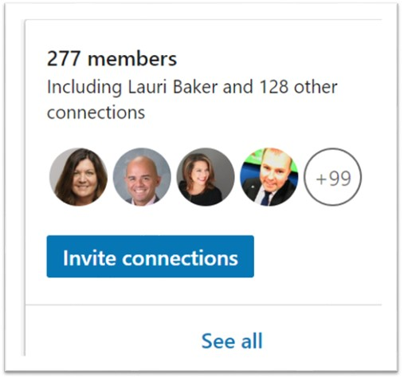
1
2
L
LINKEDIN GROUP SALES COMMUNITY
3
https://lnkd.in/ewhYesS

Slide 18
THANK
YOU

