Slide 1
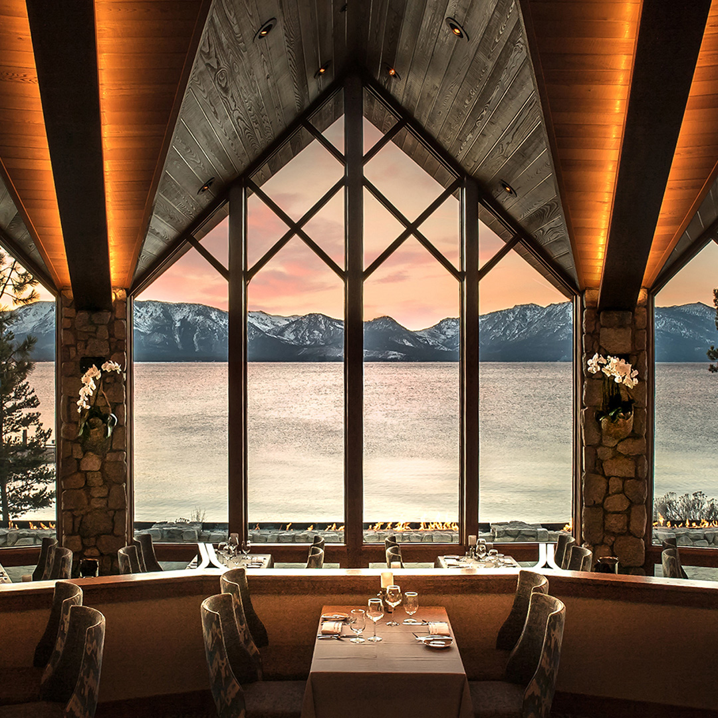
SPOTLIGHT CAMPAIGN: FOOD & DRINK
September 22 – December 31, 2022

Slide 2
THE SPOTLIGHTS: FOOD & DRINK
CAMPAIGN OVERVIEW
OBJECTIVES
Drive traffic and bookings to participating hotels from key feeder markets.​
​
Drive visibility to participating hotel's food & drink experiences through a series of engaging and targeted communications.​
STRATEGY
Showcase the unique food and drink experiences each hotel and destination has to offer. Give reason to the audience to visit these hotels and destinations.
CAMPAIGN MESSAGE
Delicious Stays with Dining Extras
Campaign Approach: Encourage travelers to visit unique dining destinations and enjoy exclusive F&B perks with the Preferred Plus offer.
TIMING
September 22 – December 31, 2022
OFFER
Preferred Plus
CONFIDENTIAL | PREFERRED HOTELS & RESORTS | THE MARKETPLACE

Slide 3
THE SPOTLIGHTS: FOOD & DRINK
CAMPAIGN MESSAGE
Delicious Stays with Dining Extras
Discover delicious destinations and experiences with our Preferred Plus offer.
Book by December 31, 2022, for stays through March 3 1, 2023, and enjoy exclusive food-related perks during your stay.​
CONFIDENTIAL | PREFERRED HOTELS & RESORTS | THE MARKETPLACE

Slide 4
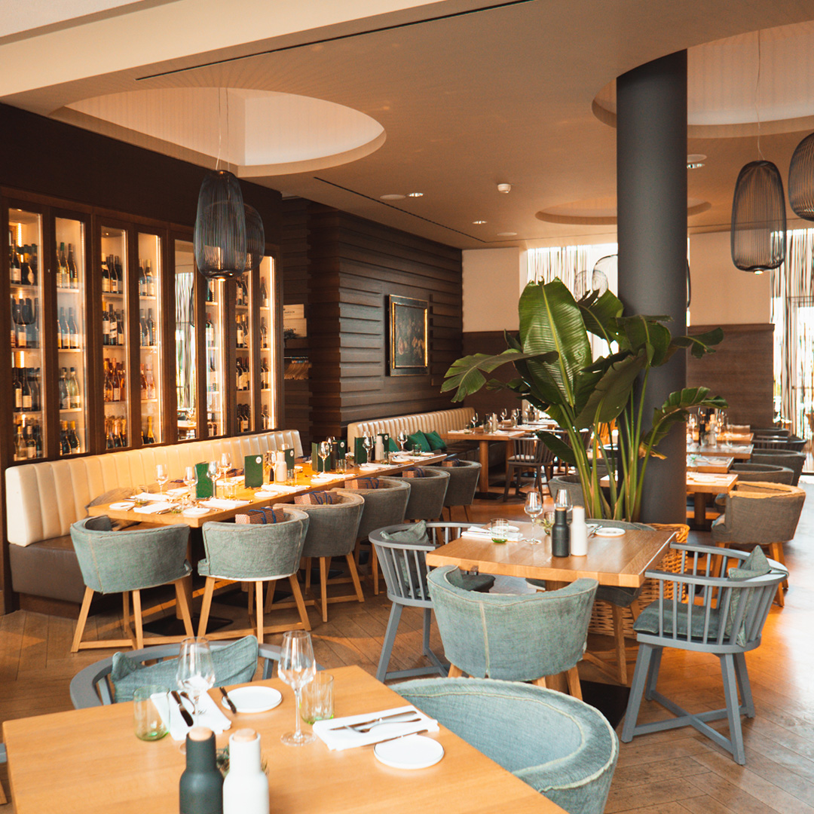
THE SPOTLIGHTS: FOOD & DRINK
TARGET AUDIENCE
I Prefer members that indicate food and wine as a preference
Past guests of participating hotels. ​
Qualified I Prefer members

Slide 5
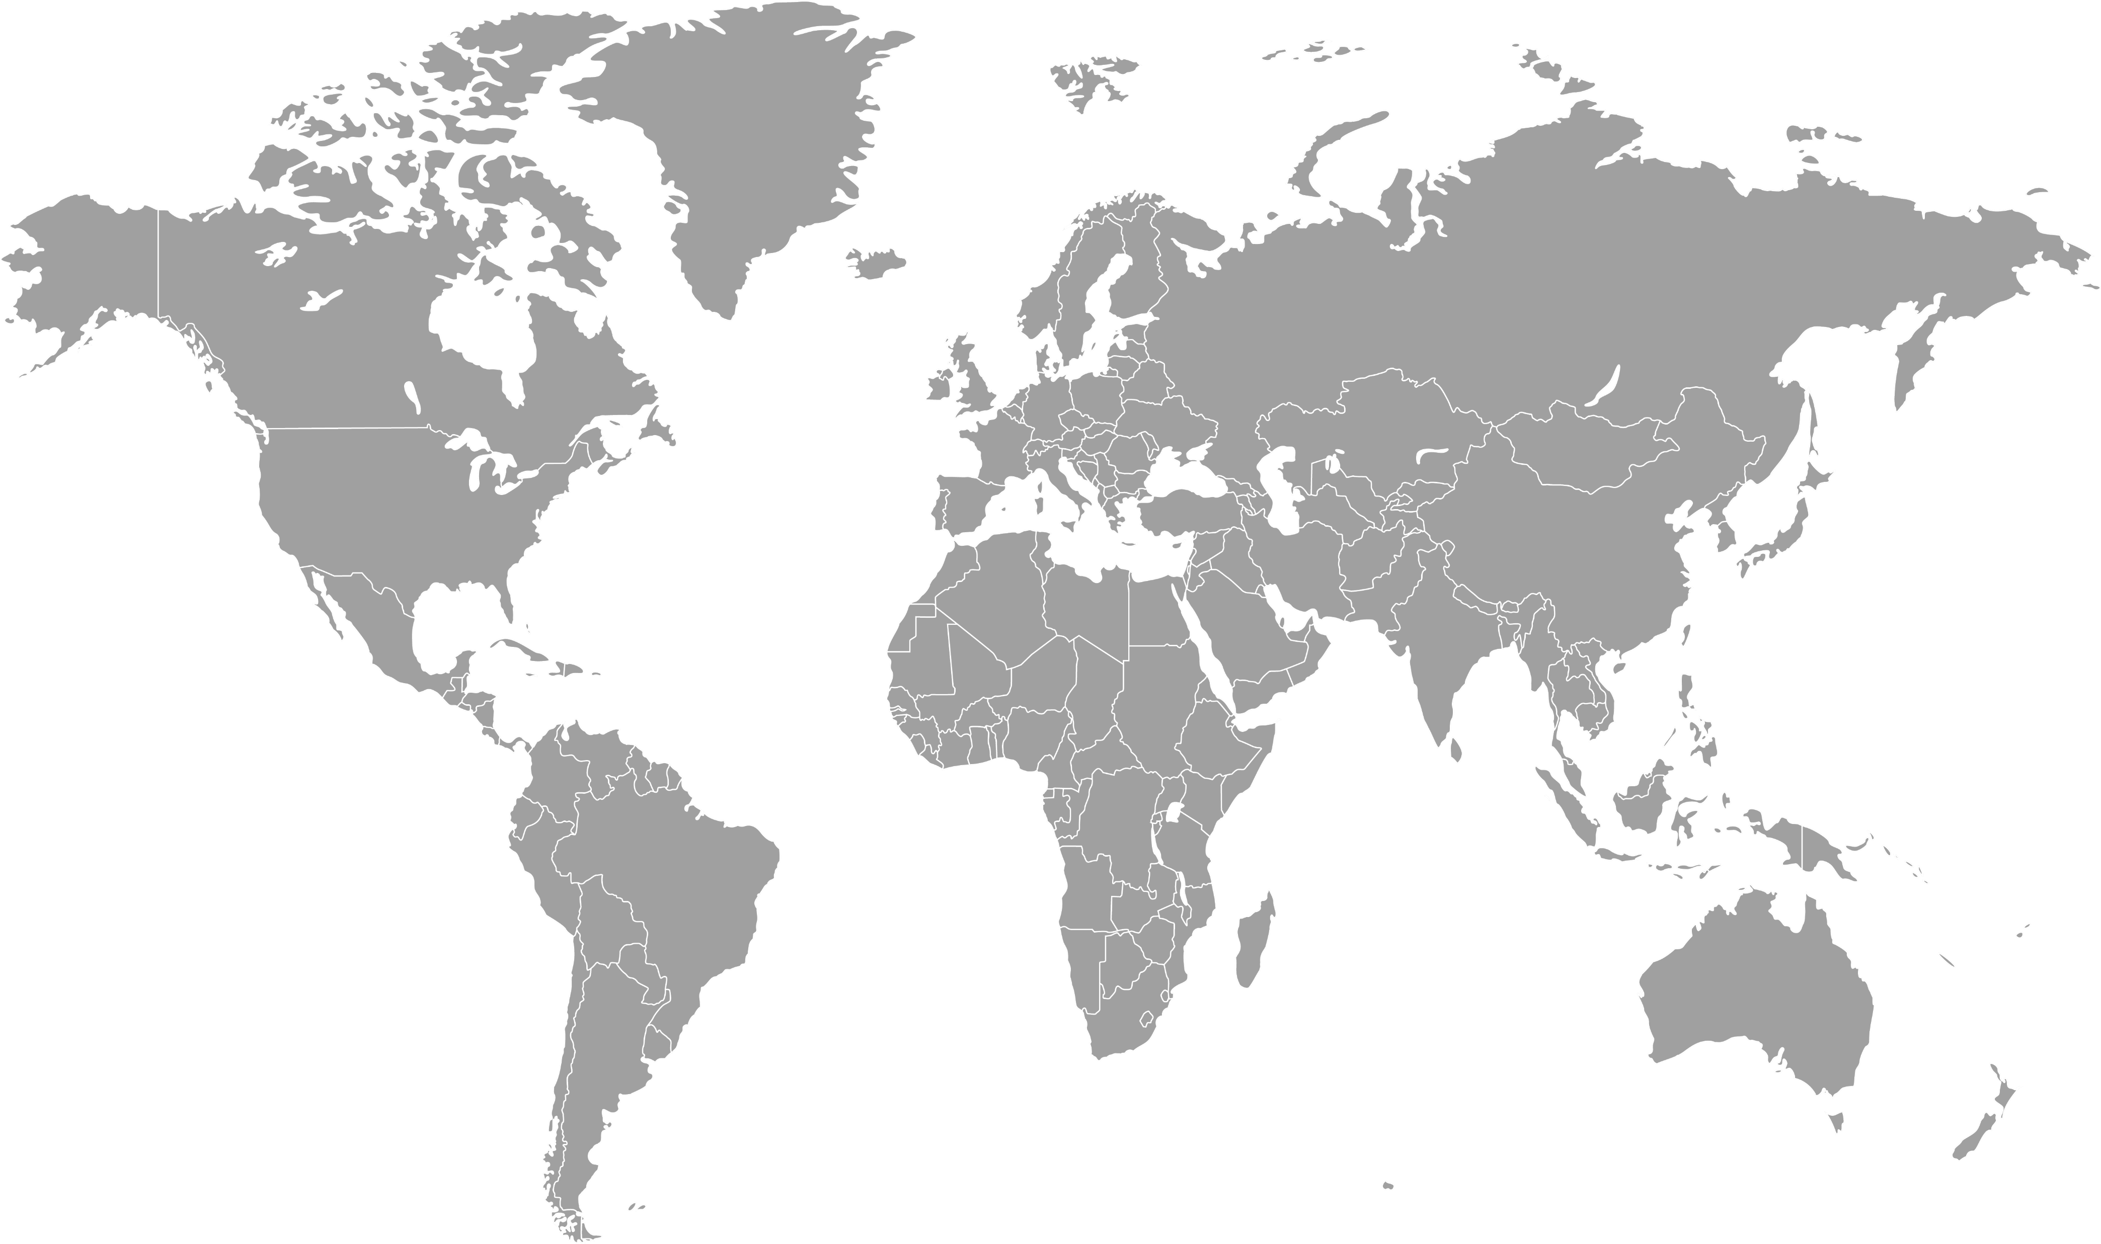
THE SPOTLIGHTS: FOOD & DRINK
PARTICIPATING HOTELS
 | PROPERTIES​ | LOCATION​
1 | Hotel Maximilian’s | Augsburg, Germany
2 | Hotel Golf Chateau de Chailly | Chailly-sur-Armancon, France
3 | Hotel Californian | Santa Barbara, California, United States
4 | Edgewood Tahoe Resort | Stateline, Nevada, United States
5 | The Wigwam | Litchfield Park, Arizona, United States
6 | Carneros Resort and Spa | Napa, California, United States
7 | Alohilani Resort Waikiki Beach | Honolulu, Hawaii, United States
8 | Preserve Sporting Club & Residences | Richmond, Rhode Island, United States
9 | Rancho Santana | Tola, Nicaragua
10 | Aurora Anguilla Resort & Golf Club | Rendezvous Bay, Anguilla
CONFIDENTIAL | PREFERRED HOTELS & RESORTS | THE MARKETPLACE

Slide 6
THE SPOTLIGHTS: FOOD & DRINK
ENGAGEMENT CHANNELS
Paid Display
Paid Social Media
Digital
Media
PHR Brand Social Media
Strategic Targeting
Online
Merchandising
I Prefer
Engagement
Email to I Prefer Member:
Segmentation strategy to complement the destination and participants​
Dedicated Landing Page
PREFERRED
GLOBAL
MARKETING
CONFIDENTIAL | PREFERRED HOTELS & RESORTS | THE MARKETPLACE

Slide 7
DIGITAL TACTICS
THE SPOTLIGHTS: FOOD & DRINK
CONFIDENTIAL | PREFERRED HOTELS & RESORTS | THE MARKETPLACE

Slide 8
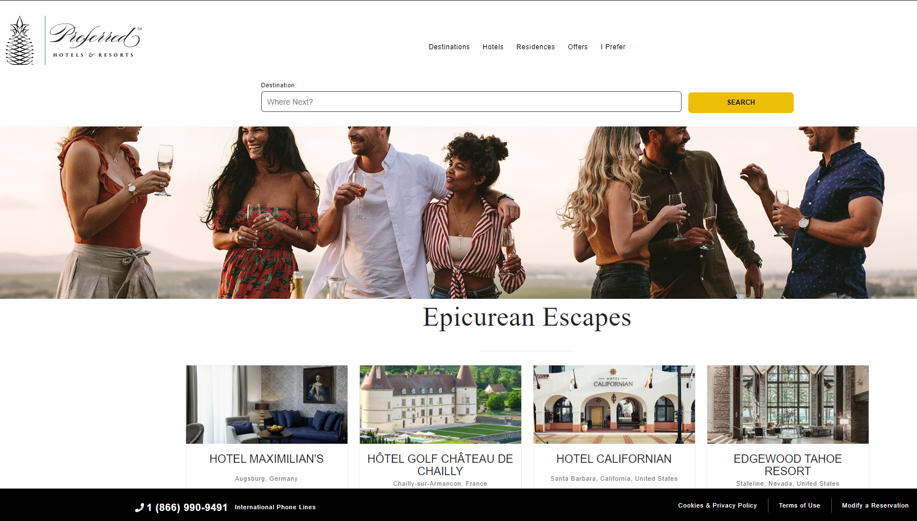
THE SPOTLIGHTS: FOOD & DRINK
PREFERRED BRAND WEBSITE
1
Dedicated landing page featuring participating hotels
2
Landing page live September 22 – December 31, 2022
3
https://preferredhotels.com/offer/food-drink
CONFIDENTIAL | PREFERRED HOTELS & RESORTS | THE MARKETPLACE

Slide 9
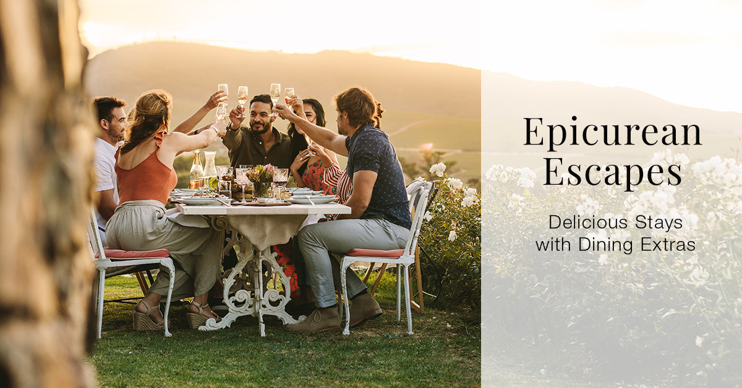
THE SPOTLIGHTS: FOOD & DRINK
PREFERRED – DIGITAL BANNER AD DISPLAY
CONTEXTUAL TARGETING
Targeting focused on people looking for unique food and drink experiences.
CUSTOM INTENT TARGETING
Targeting focused on people looking for participating properties, property names, restaurant names, keywords, and URLs.
CONFIDENTIAL | PREFERRED HOTELS & RESORTS | THE MARKETPLACE

Slide 10
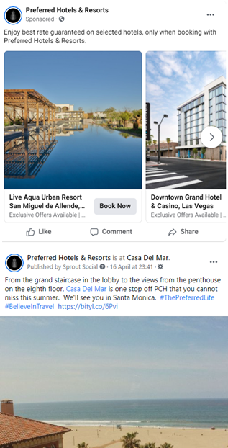
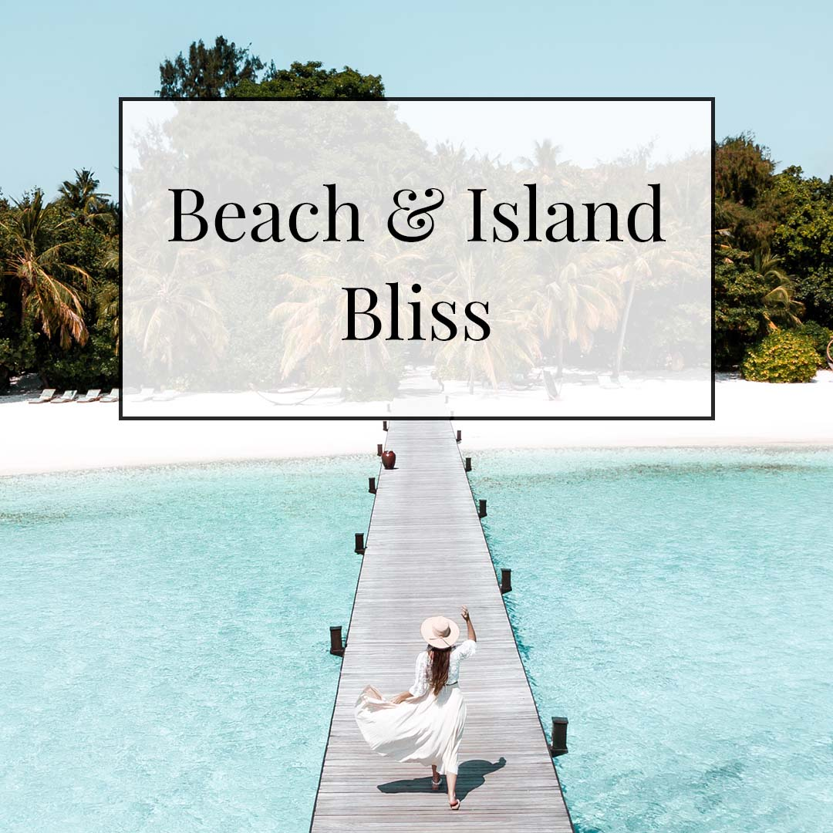
THE SPOTLIGHTS: FOOD & DRINK
PREFERRED – PAID SOCIAL MEDIA
Dynamic social media advertising to promote individual hotels and resorts, and their specific food and drink offers, to people who have expressed interest in similar properties and locations on the PH&R website, app, and elsewhere on the internet
1
2
Dynamic social media advertising to promote food and drink offers to people who have expressed interest in food and drink on the PH&R website, app, and elsewhere on the internet
3
Social media advertising targeting I Prefer Members interested in Food and Wine
CONFIDENTIAL | PREFERRED HOTELS & RESORTS | THE MARKETPLACE

Slide 11
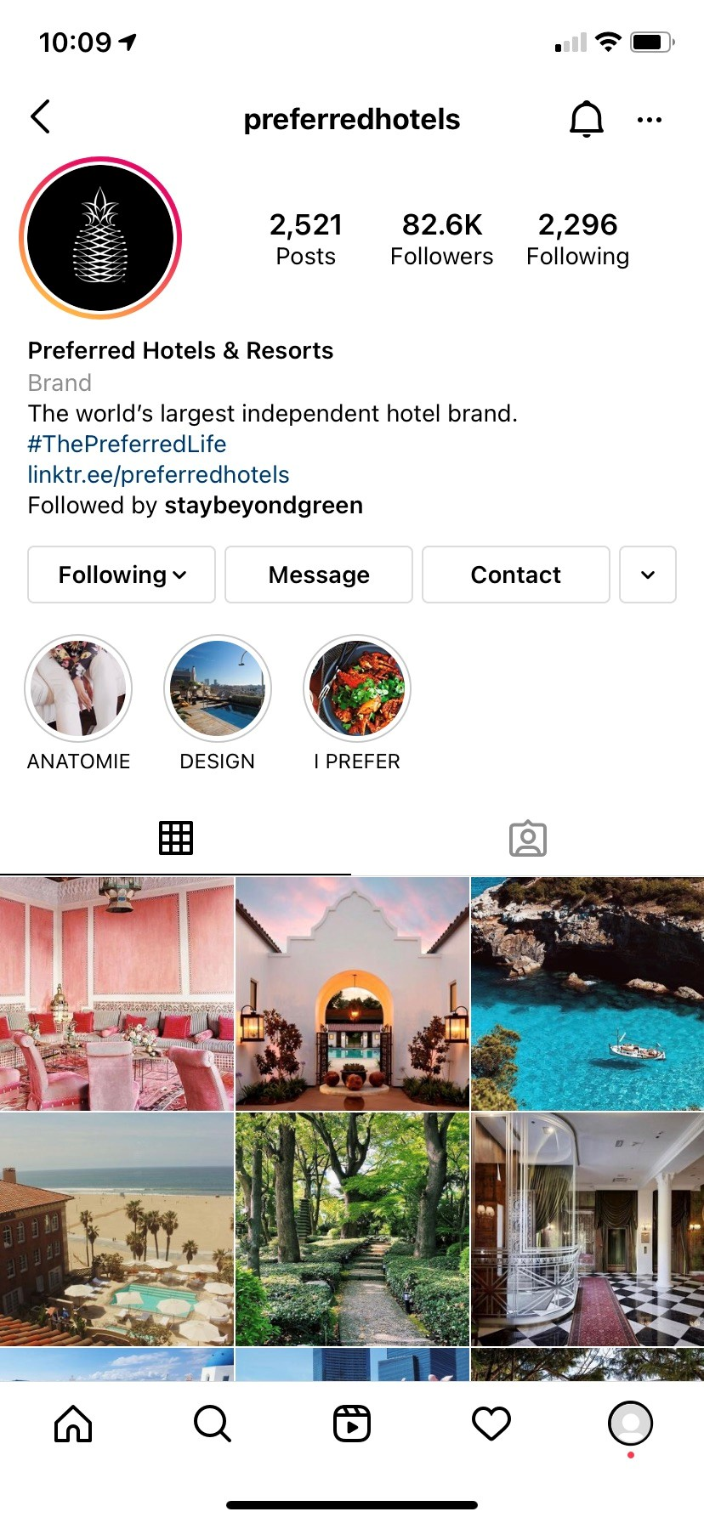
THE SPOTLIGHTS: FOOD & DRINK
BRAND SOCIAL
WE ARE STORYTELLERS…
STORIES:
instagram & Facebook Story features
Details: Stories will highlight activities at participating properties with the “swipe up” feature leading to the campaign landing page. Stories will live in a Highlight on the @PreferredHotels Instagram.
Audience Reach: 82.6k Followers
POSTS:
Facebook Posts
Details: Posts on the @PreferredHotels Facebook Page will detail the offer and participating hotel images with a direct link to the campaign landing page.
Audience Reach: 297.6k
CONFIDENTIAL | PREFERRED HOTELS & RESORTS | THE MARKETPLACE

Slide 12
I PREFER MEMBER E-MAIL
THE SPOTLIGHTS: FOOD & DRINK
CONFIDENTIAL | PREFERRED HOTELS & RESORTS | THE MARKETPLACE

Slide 13
THE SPOTLIGHTS: FOOD & DRINK
I PREFER EMAIL
1
Email supporting content relevant to the campaign theme and the participating hotels
Highly targeted audience of I Prefer members who expressed interest in food and wine plus customers with past stays at participating hotels
2
3
Deployment: September 22, 2022
CONFIDENTIAL | PREFERRED HOTELS & RESORTS | THE MARKETPLACE

